Slide 1

INSTAGRAM USER ANALYTICS
RAMISETTI ANIRUDH

Slide 2
PROJECT DESCRIPTION
This project focuses on analyzing user interactions and engagement with the Instagram app to provide actionable insights for the marketing, product, and development teams. The analysis will help the management team make informed decisions about feature enhancements, marketing strategies, and user engagement tactics. The primary tool used for this analysis is MySQL Workbench.
User analysis is a process in which we track how user engage and interact with our digital product to get insights.
The main goal of this project is to provide insights on user engagement, business, fake account to assist product team.
These insights are used by teams across the business to launch new campaigns, building new features of app, tracking user engagement with app and improve the overall user experience which helps the business grow.

Slide 3
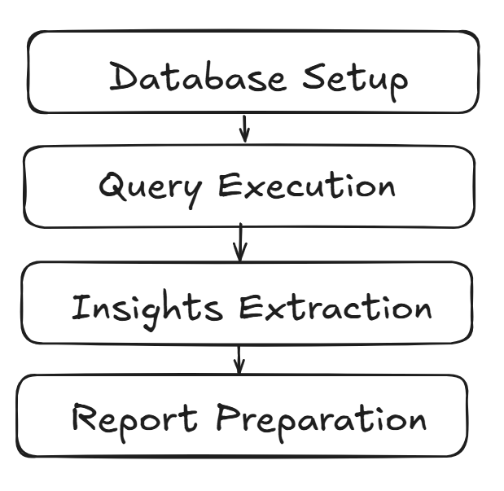
APPROACH
For this project, I have used My SQL to extract the required data from the given database using the Join function, subqueries, Aggregation, where condition, Group by, Distinct and other functions required. keeping the Primary key and foreign key in consideration provided all the reports asked by the marketing department and Investor metrics department. I have used Microsoft PPT maker to prepare the final report representation.
DATABASE -> Loaded the provided database into MySQL Workbench.
QUERY EXECUTION -> Designed and executed SQL queries
INSIGHTS EXTRACTION
REPORT PRESENTATION ->POWERPOINT

Slide 4

TECH STACK
To complete this project, I have used software MySQL workbench 8.0 CE. It is used to creating database and writing SQL queries . Additionally, I have used notepad for saving SQL query and Microsoft power point presentation to create PPT.

Slide 5
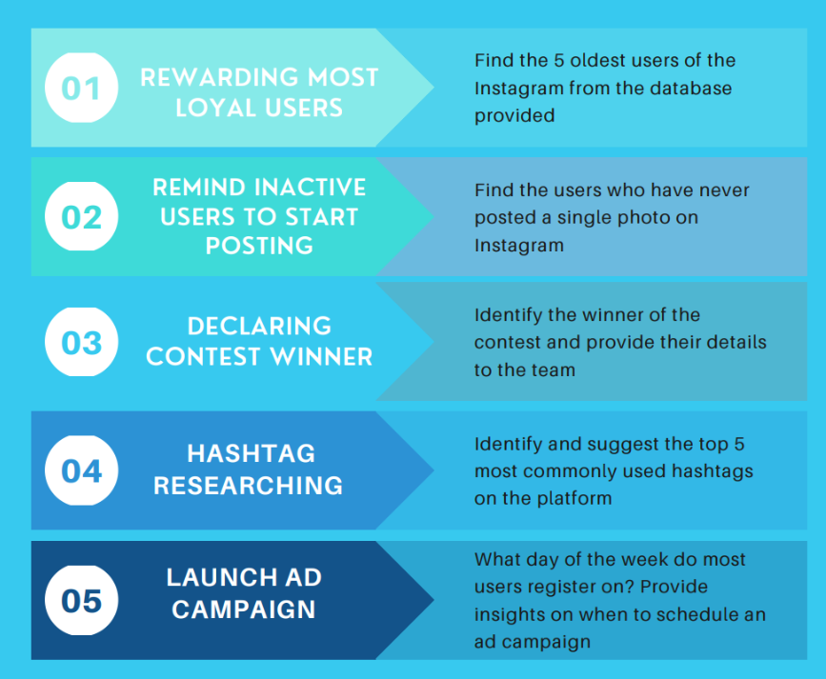
insights
Throughout the Instagram Engagement Analysis Project, several key insights emerged regarding user engagement trends, loyalty metrics, and interaction behaviors. Analyzing the data revealed distinct patterns that are instrumental for understanding how users interact with content on the platform.

Slide 6
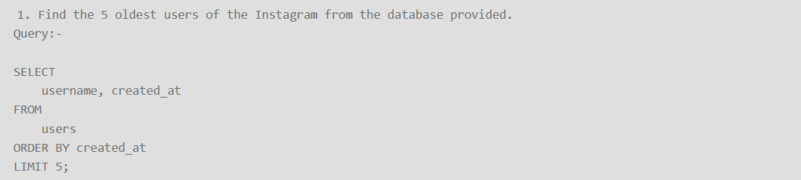
5 oldest users of the Instagram (query)

Slide 7
5 oldest users of the instagram

Slide 8
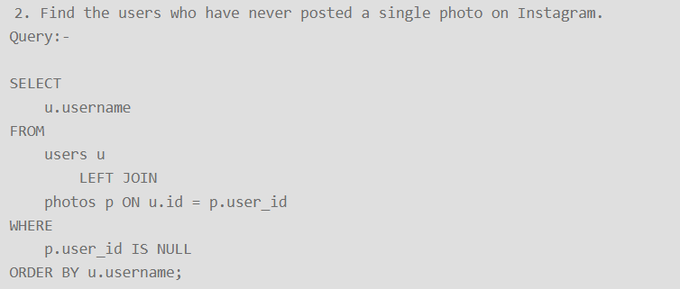
Remind Inactive Users to Start Posting(query)

Slide 9
Remind Inactive Users to Start Posting
Users who have never posted a single photo on Instagram
USERNAMES | CREATED AT
Aniya_Hackett | 07-12-16 01:04
Kasandra_Homenick | 12-12-16 06:50
Jaclyn81 | 06-02-17 23:29
Rocio33 | 23-01-17 11:51
Maxwell.Halvorson | 18-04-17 02:32
Tierra.Trantow | 03-10-16 12:49
Pearl7 | 08-07-16 21:42
Ollie_Ledner37 | 04-08-16 15:42
Mckenna17 | 17-07-16 17:25
David.Osinski47 | 05-02-17 21:23
Morgan.Kassulke | 30-10-16 12:42
Linnea59 | 07-02-17 07:49
Duane60 | 21-12-16 04:43
Julien_Schmidt | 02-02-17 23:12
Mike.Auer39 | 01-07-16 17:36
Franco_Keebler64 | 13-11-16 20:09
Nia_Haag | 14-05-16 15:38
Hulda.Macejkovic | 25-01-17 17:17
Leslie67 | 21-09-16 05:14
Janelle.Nikolaus81 | 21-07-16 09:26
Darby_Herzog | 06-05-16 00:14
Esther.Zulauf61 | 14-01-17 17:02
Bartholome.Bernhard | 06-11-16 02:31
Jessyca_West | 14-09-16 23:47
Esmeralda.Mraz57 | 03-03-17 11:52
Bethany20 | 03-06-16 23:31

Slide 10
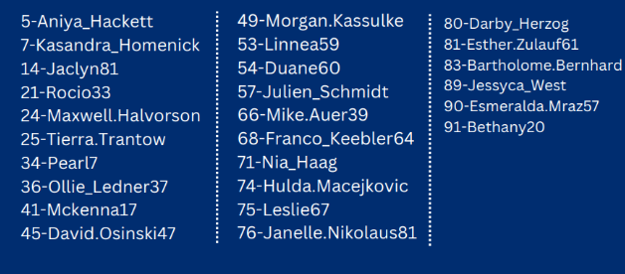
Remind Inactive Users to Start Posting
We have found a list of 26 users with their user id who have never posted a single photo on Instagram and they will be receiving promotional emails to post their 1st photo.

Slide 11
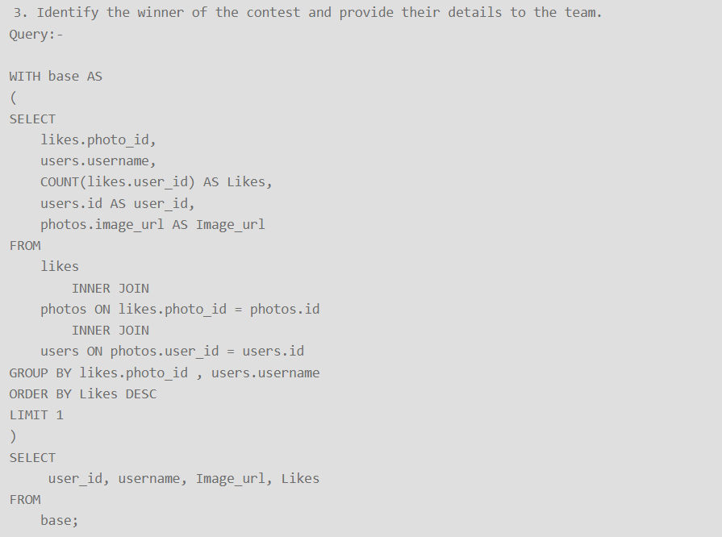
Declaring Contest Winner (query)

Slide 12
Declaring Contest Winner
Most popular photo and user
Zack_Kemmer9 (Username)
145 (id)
https://jarret.name (image url)
48 (total number of likes)

Slide 13
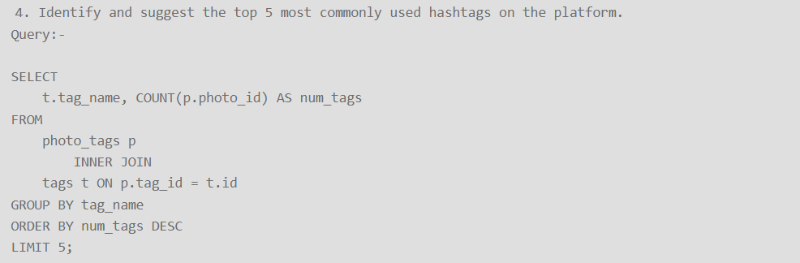
Hashtag Researching (QUERY)

Slide 14
Hashtag Researching
top 5 most commonly used hashtags on the platform
smile 59
beach 42
party 39
fun 38
Concert 24

Slide 15
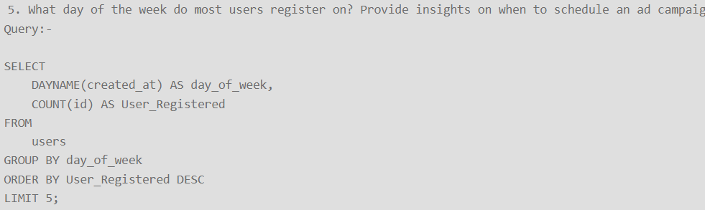
Launch AD Campaign(query)

Slide 16
Launch AD Campaign
Thursday 16
Sunday 16
Friday 15
Tuesday 14
Monday 14
Wednesday 13
Saturday 12
Here are the day name and no. of user
registered on

Slide 17
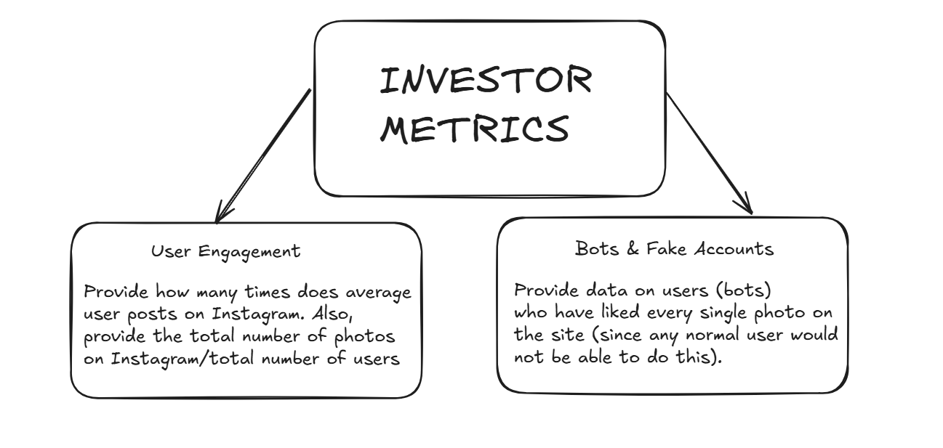
INVESTor METRICS

Slide 18
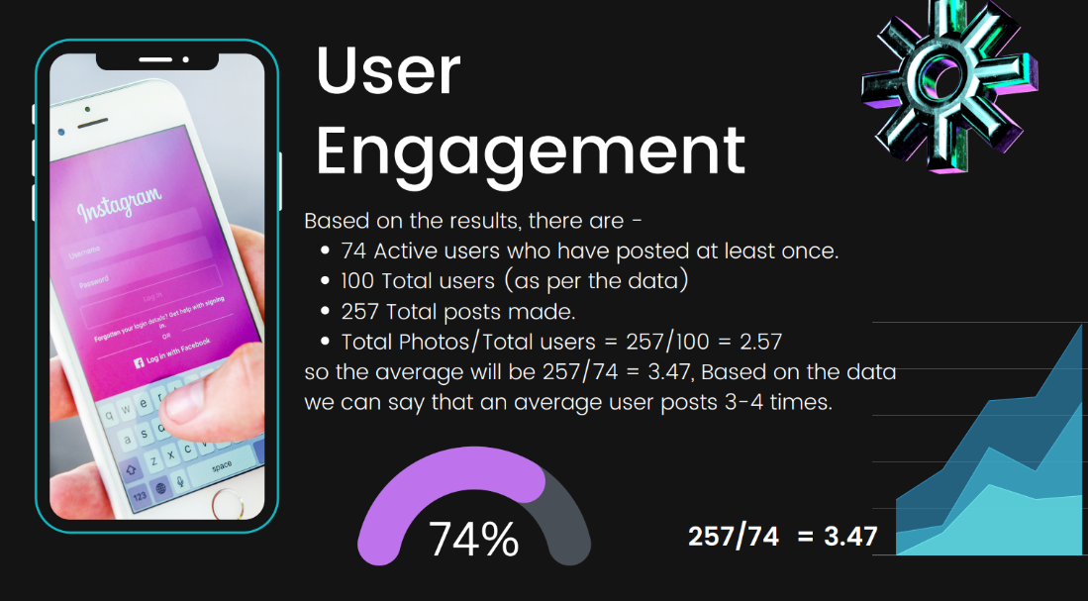
User Engagement (query)

Slide 19
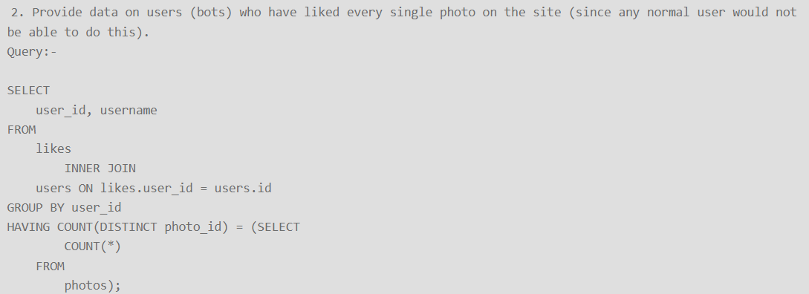
Bots & Fake Accounts (query)

Slide 20
Bots & Fake Accounts
Finding the users who likes every photos.
Here are the list of user who likes every photos on Instagram
USERNAME | NUMBER OF LIKES
Aniya_Hackett | 257
Jaclyn81 | 257
Rocio33 | 257
Maxwell.Halvorson | 257
Ollie_Ledner37 | 257
Mckenna17 | 257
Duane60 | 257
Julien_Schmidt | 257
Mike.Auer39 | 257
Nia_Haag | 257
Leslie67 | 257
Janelle.Nikolaus81 | 257
Bethany20 | 257

Slide 21
RESULT
The Instagram user analytics project provided insights on marketing, User engagements, Bots and Fake accounts. Now these insight can be used by Instagram product team to launch new campaigns, track users engagement and improve user experience
Here are the insights I found in these project
Top 5 Oldest users of Instagram
Users who never posted photos on Instagram
Most liked photo on Instagram
Top 5 most commonly used has-tags on Instagram
Total number of users on Instagram
Total number of photos on Instagram
Average number of photos per user
Bots and fake accounts on Instagram

Slide 22
Drive and github links
GOOGLE DRIVE – “ Drive “
GITHUB –” Github ”

